Slide 1
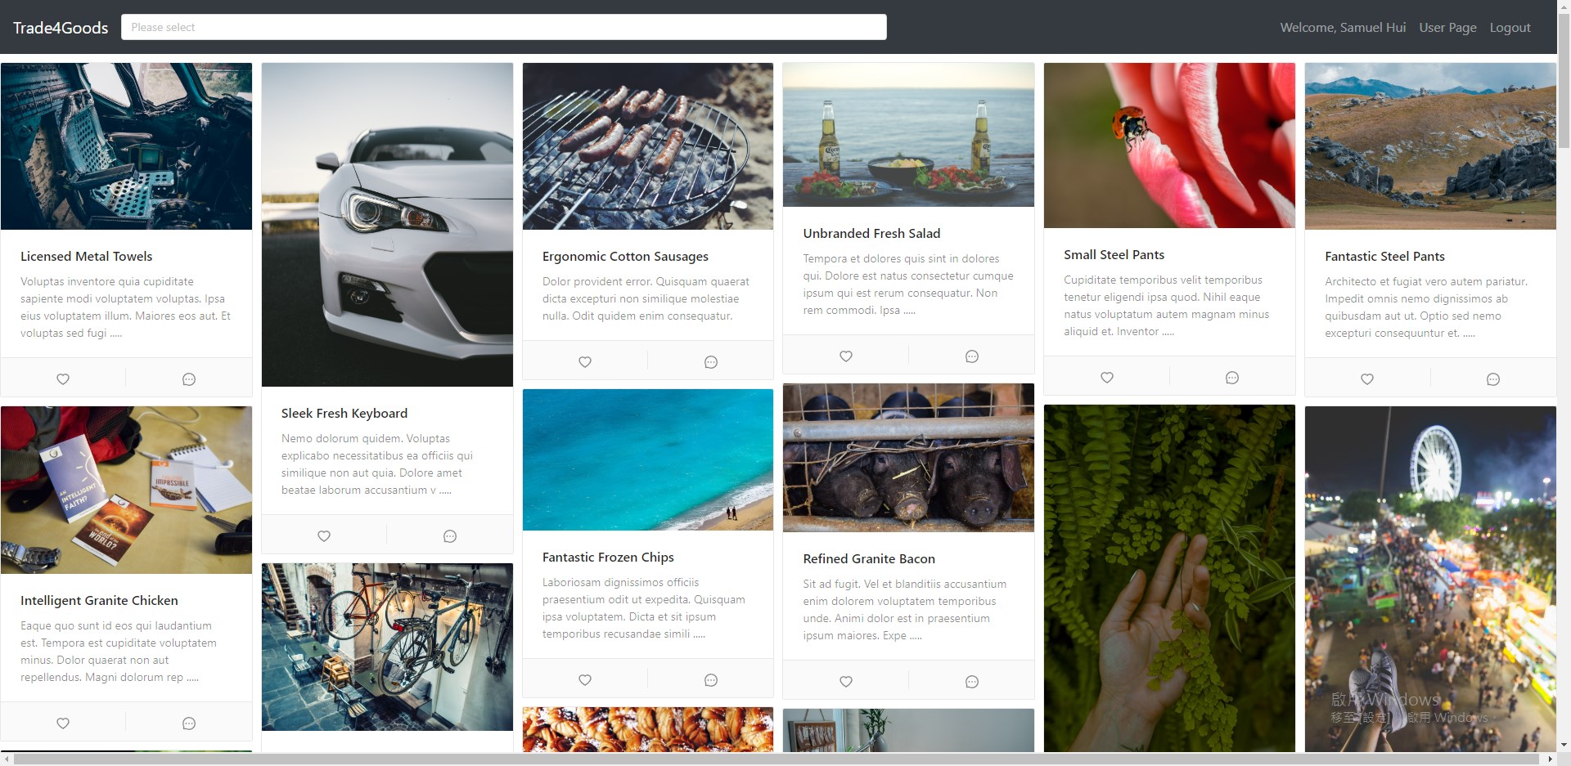
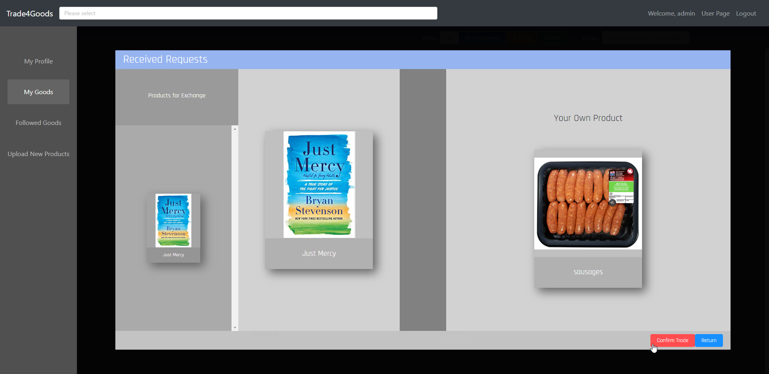




Motivation
No online barter platform in Hong Kong
Problem: Sharing second-hand or unusable products with the public
Our Solution: Hong Kong first online barter trading platform, Trade4Goods
Main features: C2C Goods Exchange Service with zero transaction fee
Trade4Goods, Barter Platform
Pick any item on the page and start to trade!
Complete the trade with only few clicks!
Powered By

Slide 2
Trade4Goods
A Barter Exchange Platform
Members: Jacky Chan, Samuel Hui, Matthew Lee

Slide 3
Motivation
No online barter platform is available in Hong Kong
Most online product trading platform involves money trading
Problem: Sharing second-hand or unusable products
Our Solution: Trade4Goods barter platform
Main features: C2C Goods Exchange Service with zero transaction fee

Slide 4




















Architecture and Technologies used
Cloud
HOST
Server
Client
Browser

Slide 5
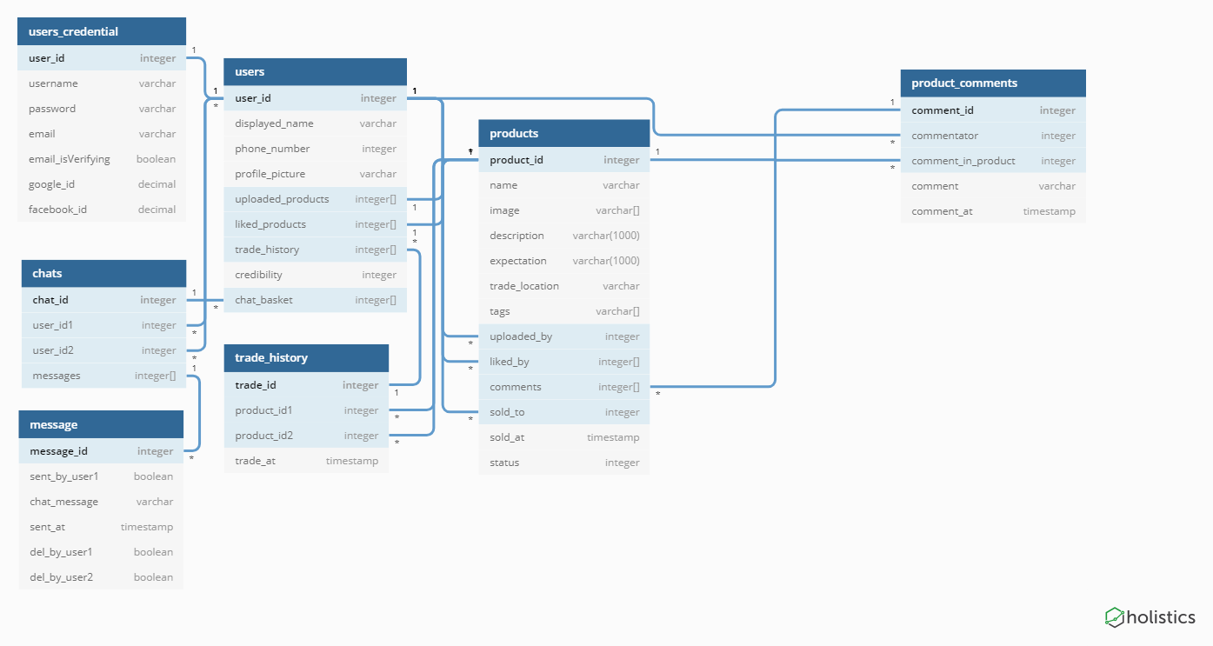
Database Design

Slide 6
Layout - Home Page
Different Goods and Product are shown on the main page

Slide 7
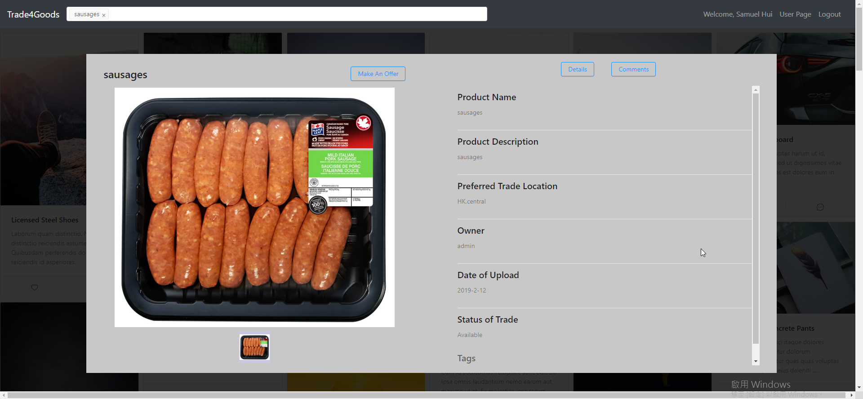
Layout - Picking Products
Pick your favourite goods and make a offer!

Slide 8
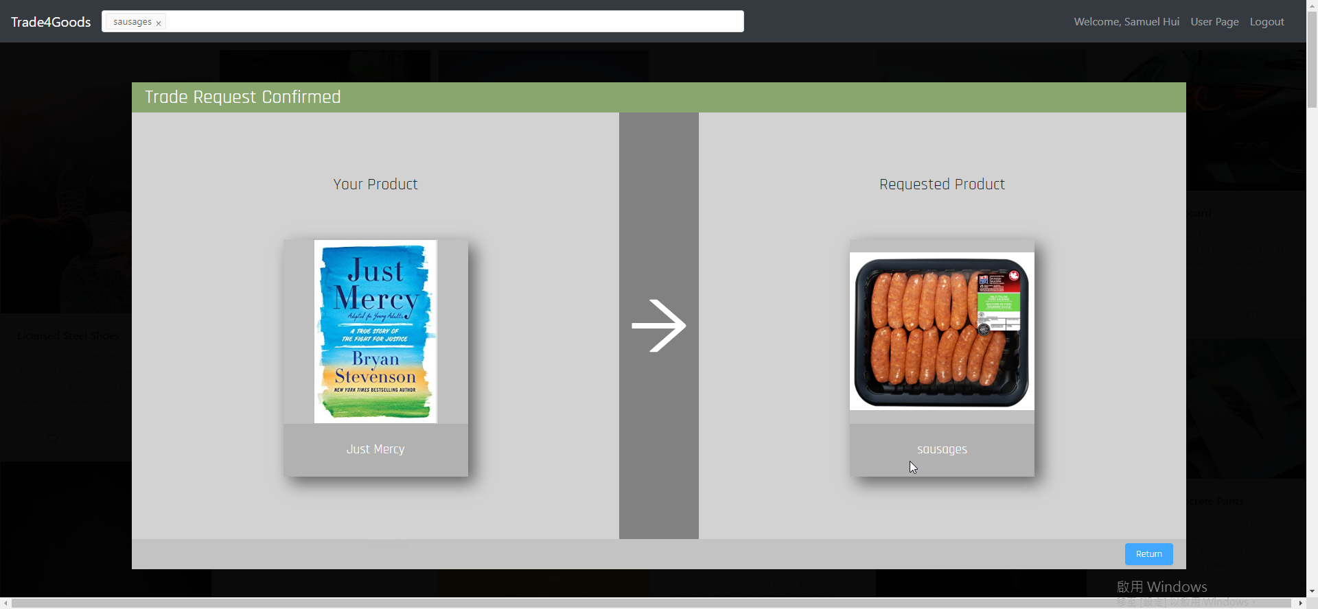
Layout - Trading
Confirm the item that you want to trade

Slide 9
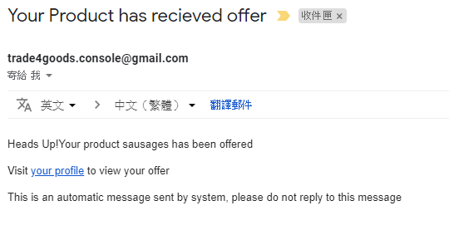
Layout - Complete Trade
You will receive an email after the deal is successfully made!

Slide 10
Upcoming Features
Private Chat Room
Instant notification
Multiple Goods basket exchange
Credibility System
Popular Category Algorithm

